Slide 1
DJANGO
A Python
Web Framework

Slide 2
Course Duration and Pre-requisites
Web application development using Django Framework – Building blocks
24 hours course
This course aims to give basic introduction on how to build a web application using Django from scratch.
Pre-Requisites
A good knowledge of HTML, CSS, Bootstrap is advisiable.
Basics of Python Programming

Slide 3
Course Contents
Introduction to web application
Role of a Web application developer
Web application development using Django – Building blocks
Installing Django and creating a Django project (Module – 1)
Building an app inside a Django project (Module – 2)
Creating templates (Module – 3)
Building Django models (Module – 4)
Working with Django forms (Module – 5 & 6)
Authentication, Authorization and Custom Models (Module – 7)
Additional Functionalities (Module – 8)

Slide 4
Web Application – Introduction
What is a Website?
Client – Server Model
Understanding url patterns
Need for a Server based application

Slide 5
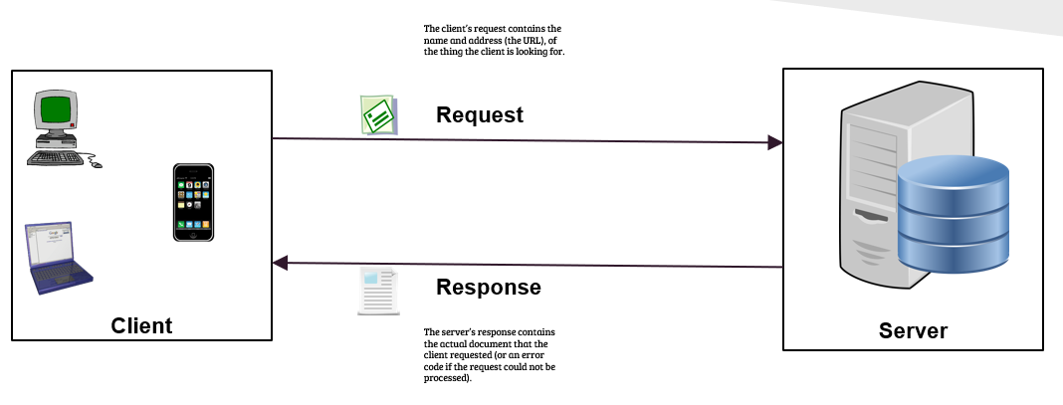
client – server model
Notes:
Direct response.
Indirect response.

Slide 6
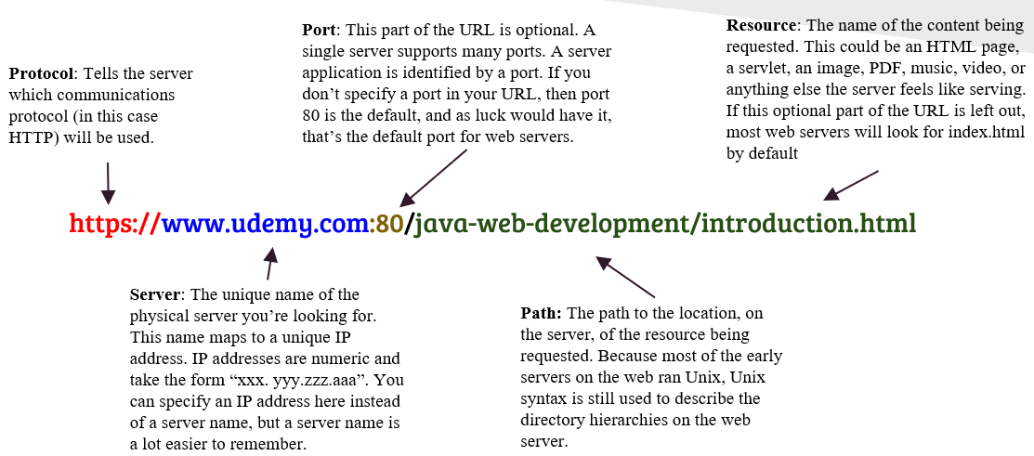
URL patterns

Slide 7
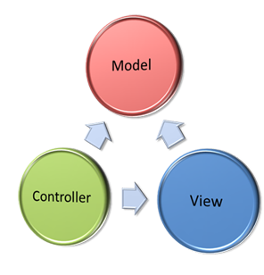
Mvc architecture
Model View Controller or MVC as it is popularly called, is a software design pattern for developing web applications.
The Model: The model is responsible for managing the data of the application. It responds to the request from the view and it also responds to instructions from the controller to update itself.
The View: It means presentation of data in a particular format, triggered by a controller's decision to present the data.
The Controller: The controller is responsible for responding to the user input and perform interactions on the data model objects. The controller receives the input, it validates the input and then performs the business operation that modifies the state of the data model.

Slide 8
Django – big picture
Django is a free and open source web application framework, written in Python and based on MVC Pattern.
A web framework is a set of components that helps you to develop websites faster and easier.
Django’s models provide an Object-relational Mapping (ORM) to the underlying database.
A Django template is a text file designed to separate an application’s data from the way it is presented.
Django’s views are the information brokers of a Django application. A view sources data from your database (or an external data source or service) and delivers it to a template.

Slide 9
Installing Django
Steps | Description | Syntax
01 | Verify Python installation | $ python -V
02 | Set up virtual environment Activate the virtual environment | $ python -m venv exmple $ example\Scripts\activate
03 | Upgrade pip command (not always needed) Install Django Check Django version | $ python -m pip install --upgrade pip $ python -m pip install django $ python -m django --version

Slide 10
Creating a project
Steps | Description | Syntax
01 | Create Project | $ django-admin.exe startproject mysite
02 | Set up the project model (run this command for first time and then every time models are updated) | $ python manage.py migrate
03 | Start the server | $ python manage.py runserver

